Slide 1



Find, Engage, and Win Business Owners
A proven sales playbook for advisors ready to build their pipeline
Dr Craig West
Founder & Chairman
Capitaliz and Succession Plus

Slide 2
By the end of this session, you’ll have:
A detailed Ideal Client Profile (ICP)
A framework for understanding the business owner acquisition journey
Three proven lead generation playbooks
Two engagement strategies that create conversations
Real-world outreach and follow-up scripting
A practical 90-day action plan
Dr Craig West | Find, Engage, and Win Business Owners

Slide 3
SECTION 01
The Real Problem
Why most advisors struggle to find clients – and the reframe that changes everything.
Dr Craig West | Find, Engage, and Win Business Owners

Slide 4



The #1 Challenge
What advisors tell us every day
“ I don’t have any clients.
What do I do?”
Hard to find
Business owners are busy running their businesses and rarely wake up looking for an advisor.
Hard to engage
Even when you identify the right owner, securing meaningful conversations can be difficult.
Hard to convert
Many opportunities stall because advisors lack a structured pathway from initial interest to paid engagement.
Dr Craig West | Find, Engage, and Win Business Owners

Slide 5

The Opportunity
Why now?
$14T
Great Wealth Transfer
The largest transfer of privately-owned business wealth in history is underway.
70-90%
of an owner's wealth is typically trapped in a single, illiquid asset – their business.
Millions of owners are asking:
What is my business really worth?
Can I afford to retire?
Who will take over?
How do I maximize value before I exit?
How do I protect my family and legacy?
The good news:
Most owners know they should be planning.
Very few know where to start.
That creates a significant opportunity for advisors who can provide clarity.
Dr Craig West | Find, Engage, and Win Business Owners

Slide 6
The Business Owner Acquisition Journey
Every prospect moves through five stages
Awareness
"I know I should think about this."
1
Interest
“This might apply to me.”
2
Diagnosis
“Where do I stand?”
3
Planning
“What should I do next?”
4
Implementation
“Help me execute.”
5
Dr Craig West | Find, Engage, and Win Business Owners

Slide 7
SECTION 02
Your Ideal Client Profile
Knowing exactly who to target is the foundation of every effective sales strategy.
Dr Craig West | Find, Engage, and Win Business Owners

Slide 8
Ideal Client Profile
Best fit business owners
Revenue
Employees
$2M – $50M
5 – 150
Owner Age
Ownership
Typically 45-65
Founder-led or privately owned
Industry
Any established owner-managed business
Dr Craig West | Find, Engage, and Win Business Owners

Slide 9

What Keeps Business Owners Awake at Night?
x Pain Points
“What is my business worth?“
"Can I afford to retire?“
"Who takes over if I'm gone?“
"Is my business too dependent on me?“
"Am I leaving money on the table?“
✓ Aspirations
Freedom
Security
Legacy
Growth
More options
Dr Craig West | Find, Engage, and Win Business Owners

Slide 10
Advisor Message Framework
A simple positioning statement
I help business owners understand what their business is worth today, identify what's holding value back, and build a roadmap to maximize value before a future transition.
✓ Simple.
✓ Relevant.
✓ Outcome-focused.
Dr Craig West | Find, Engage, and Win Business Owners

Slide 11
SECTION 03
Three Lead Generation Playbooks
High-level overview of three strategies already generating results for advisors in this space.
Dr Craig West | Find, Engage, and Win Business Owners

Slide 12
PLAYBOOK 01
The highest-converting lead generation tool in Capitaliz.
Why?
Owners receive immediate insight.
No sales pitch.
No obligation.
Pure value first.
The Value Gap
Assessment (VGA)
Strategy
Dr Craig West | Find, Engage, and Win Business Owners

Slide 13
How the VGA Creates Opportunities
Step 1
Step 2
Step 3
Step 4
Step 5
Owner completes assessment.
Owner receives insights.
Value gap becomes visible.
Advisor discusses findings.
Engagement begins. The assessment creates the conversation.
Dr Craig West | Find, Engage, and Win Business Owners

Slide 14
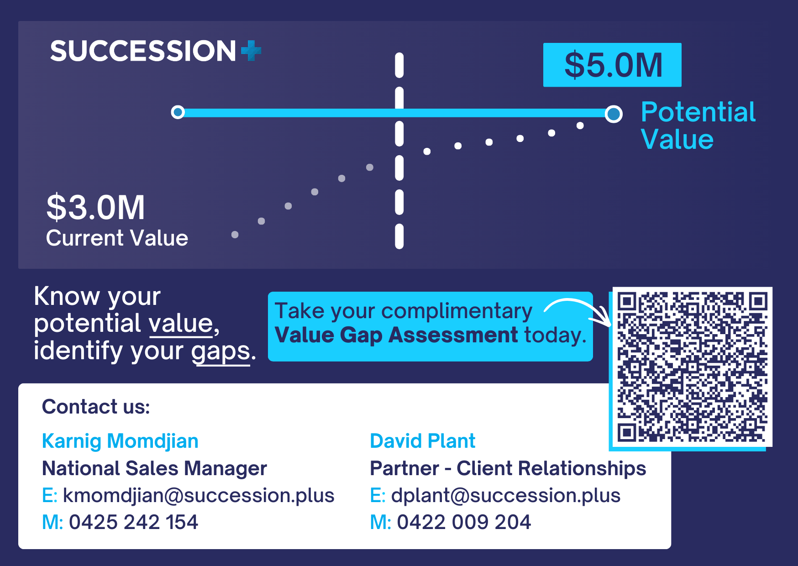
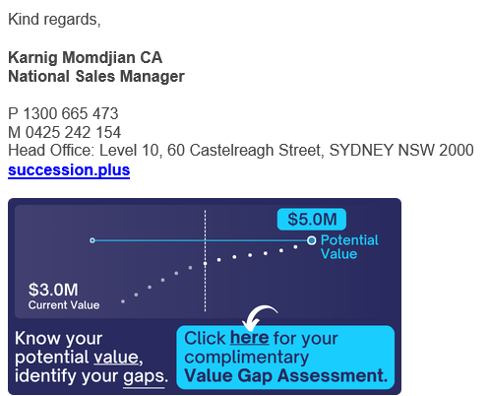
Where to Use the VGA
The most successful advisors place their VGA everywhere.
Examples
Email signature
Website CTA
Landing pages
LinkedIn profile
Newsletter campaigns
Webinar follow-up
QR codes
Event presentations
Referral partner conversations
Email signature
Event postcard
Dr Craig West | Find, Engage, and Win Business Owners

Slide 15
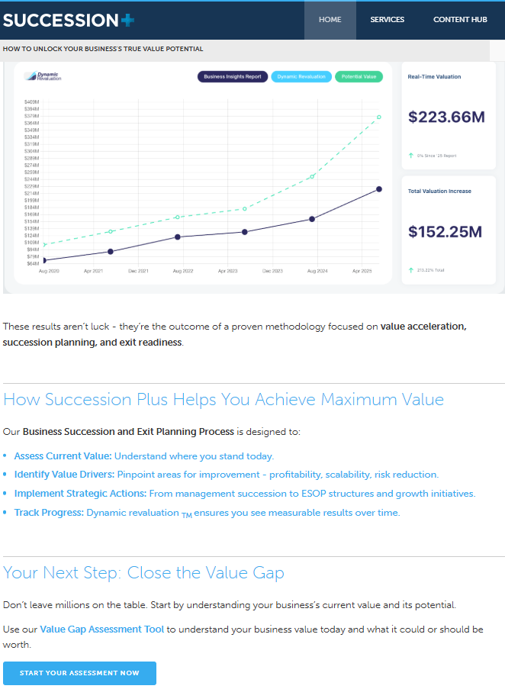
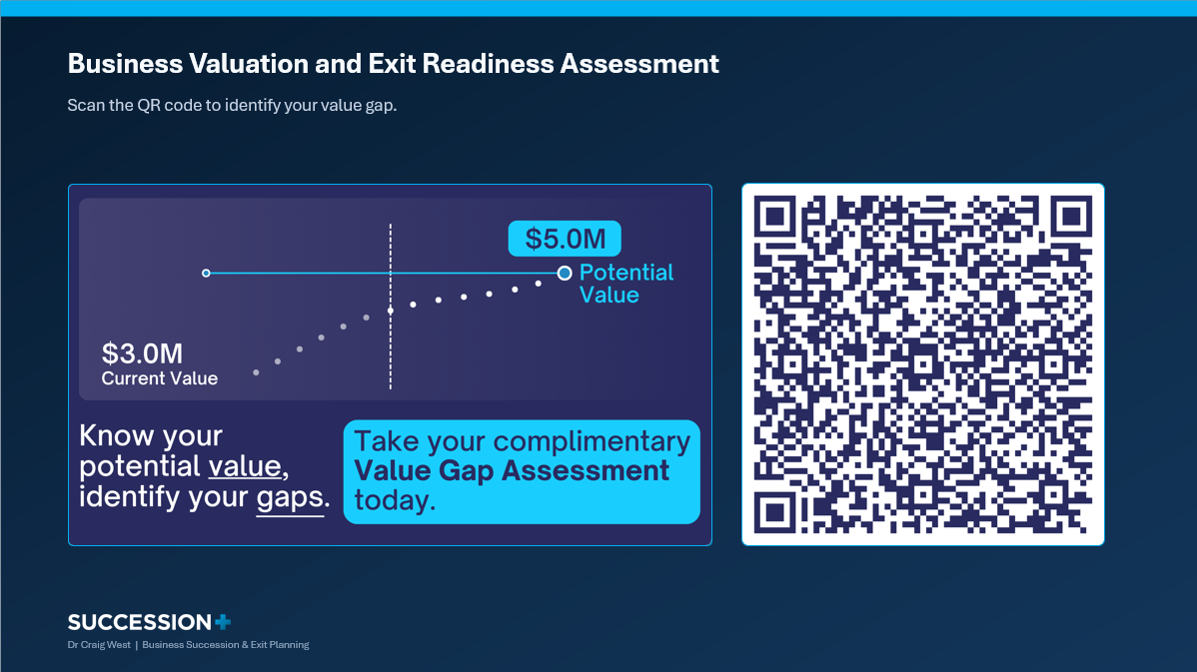
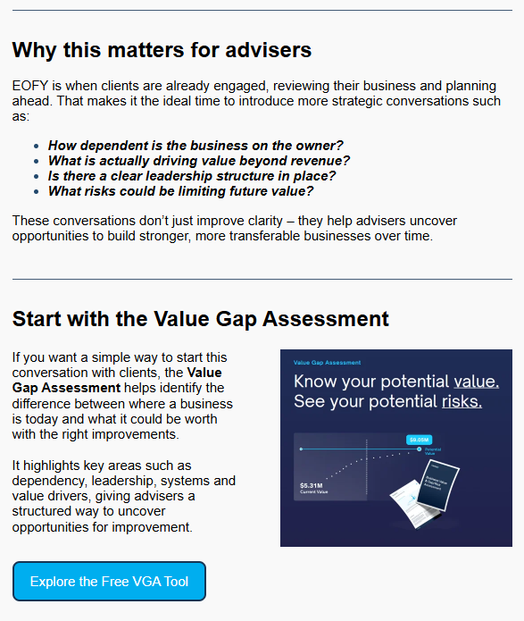
Website article
Where to Use the VGA
Presentation
Marketing:
Website CTAs
Articles
Seminars/Webinars
Email campaigns
Sales
Discovery meetings
Follow-up conversations
Referral introductions
Conversion
Business Insights Reports
Strategic planning engagements
Newsletter
Dr Craig West | Find, Engage, and Win Business Owners

Slide 16
PLAYBOOK 02
The fastest path to warm opportunities.
Partners already have trusted relationships.
You simply provide additional value.
Creating a Repeatable Referral Engine
Dr Craig West | Find, Engage, and Win Business Owners

Slide 17

Building a Referral Network Around Owner Triggers
Focus on people who already serve your ideal client.
Centers of Influence
Accountants
Lawyers
Bankers
Wealth advisors
Business coaches
M&A advisors
Insurance advisors
Industry association leaders
Dr Craig West | Find, Engage, and Win Business Owners

Slide 18
What to Ask Them
The win is not asking COIs for referrals in general.
The win is giving them a simple trigger and an easy next step.
Which clients are asking about succession, valuation, retirement, or transition?
Which clients are too dependent on the owner?
Which clients have growth potential but no clear plan?
Which clients may need a structured diagnostic before taking advice?
Referral offer
“If you have a client who would benefit from understanding their value gap, I can run an initial diagnostic and share the key insights with them. It gives them clarity and gives us a better starting point for advice.”
Follow-up rhythm
Initial COI meeting
Send sample VGA output
Offer one pilot client assessment
Share a monthly owner insight
Track referrals and outcomes
Dr Craig West | Find, Engage, and Win Business Owners

Slide 19
The Referral Conversation
Don’t ask:
“Can you refer me to clients?”
A much easier conversation.
A much easier introduction.
Ask:
“Which of your clients would benefit from understanding their value gap?”
Dr Craig West | Find, Engage, and Win Business Owners

Slide 20
PLAYBOOK 03
Content pillars
Exit readiness
Business value and value gap
Key risks that reduce business value
Owner dependence
Governance and transferable value
Succession options
Preparing for sale or transition
Value acceleration
Content that creates owner conversations
Dr Craig West | Find, Engage, and Win Business Owners

Slide 21
Content Formats and Messaging Framework
Deliver relevant, educational content that demonstrates value
High-performing formats
Blog post or article
1-page checklist
Short video
Webinar
Social media posts
Email newsletter
Downloadable guide
Case study or hypothetical example
Simple content formula
Name the owner problem
Explain why it matters commercially
Share one practical insight
Offer the VGA or discovery call as the next step
Dr Craig West | Find, Engage, and Win Business Owners

Slide 22
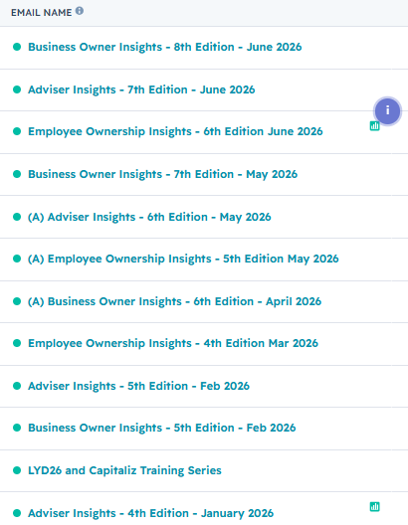
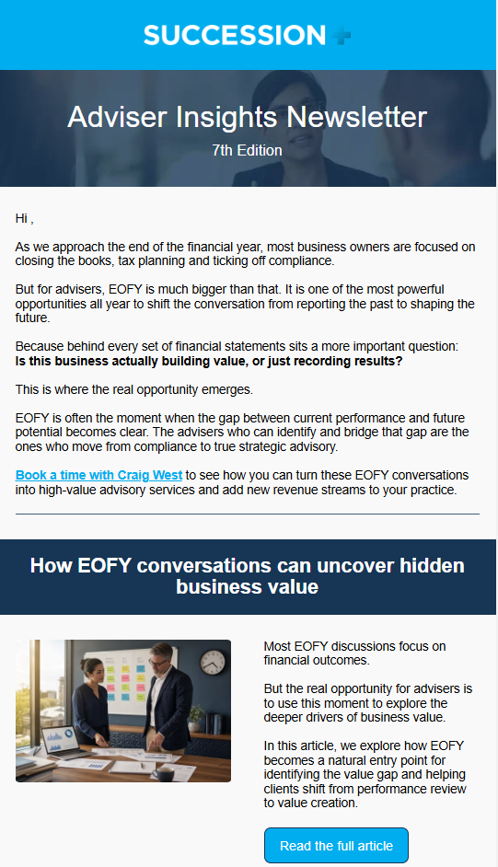
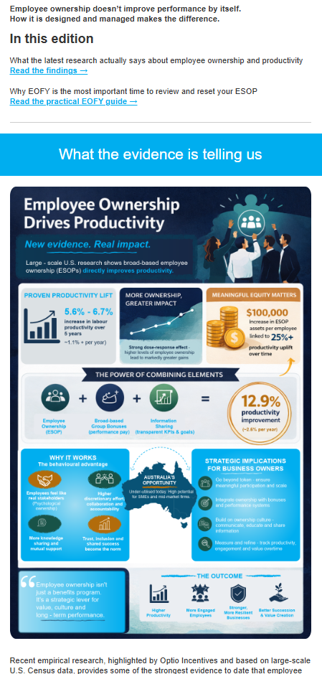

Sample Newsletters
Consistent email communication that builds trust, delivers value, and generates future opportunities.
Dr Craig West | Find, Engage, and Win Business Owners

Slide 23
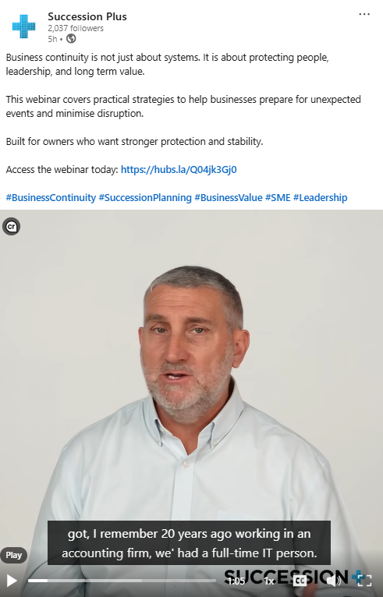
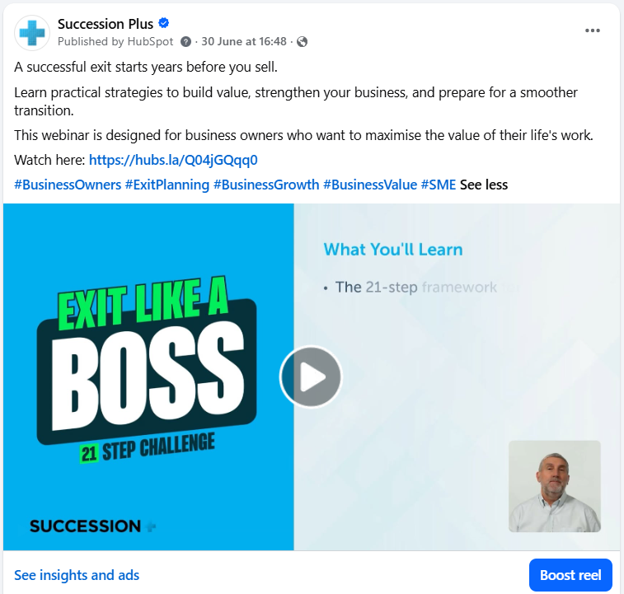
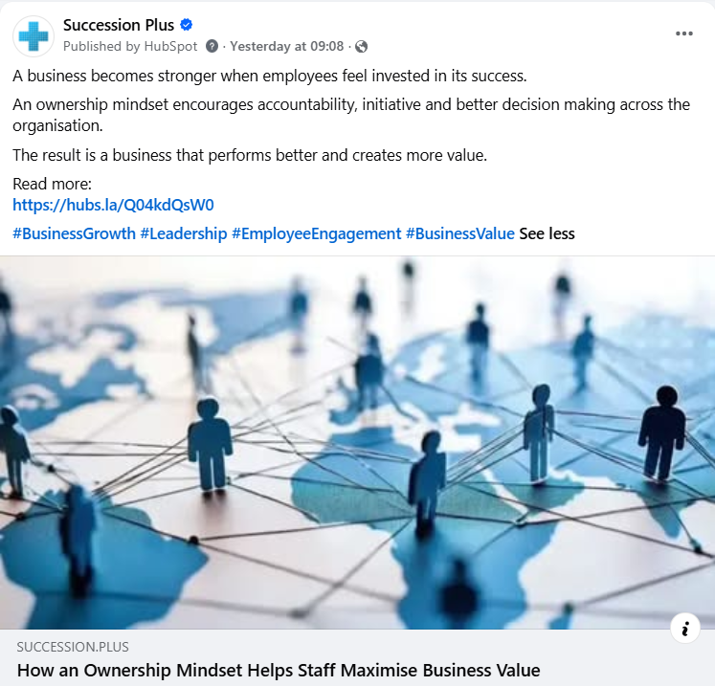
Sample Social Media Posts
Dr Craig West | Find, Engage, and Win Business Owners

Slide 24
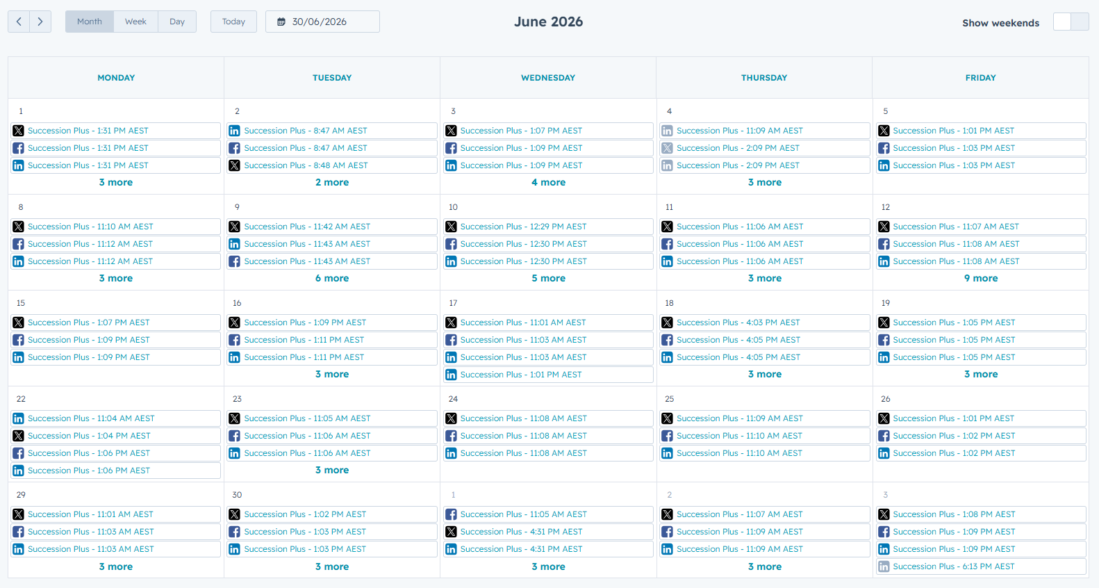
Social Media Strategy
Use a structured content calendar to maintain a consistent presence, strengthen your brand, build credibility, and stay top of mind with clients and referral partners.
Dr Craig West | Find, Engage, and Win Business Owners

Slide 25
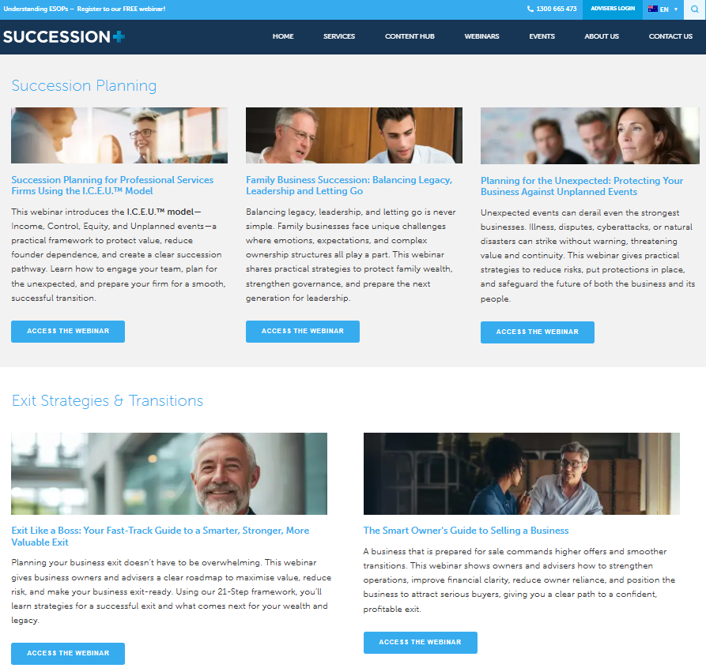
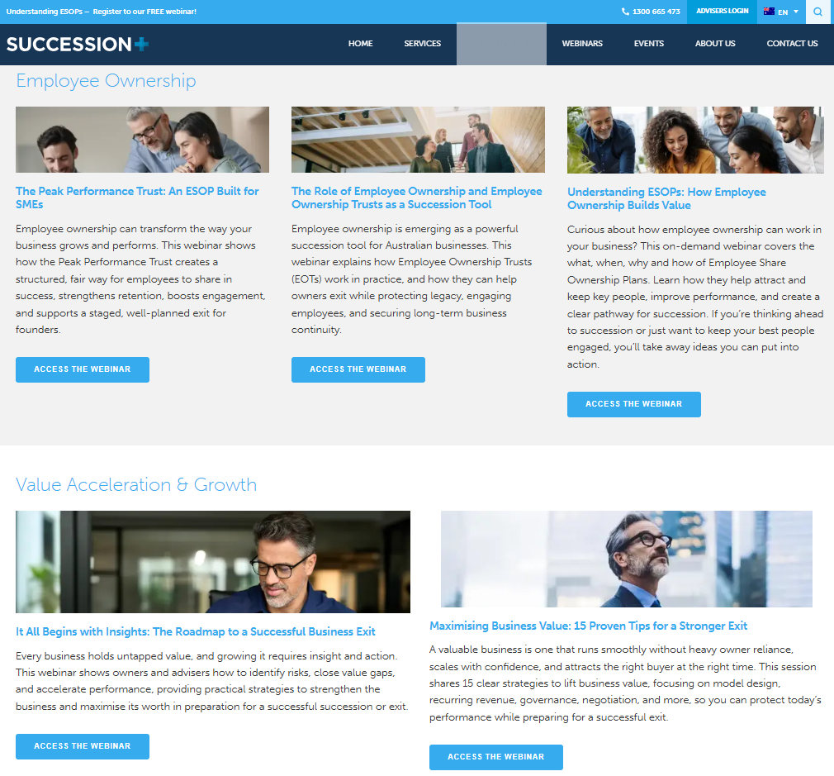
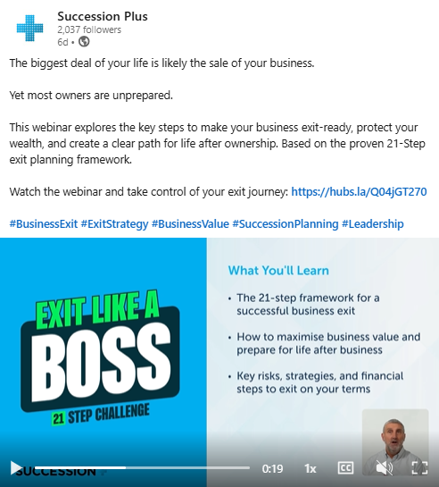
Sample Webinars
Dr Craig West | Find, Engage, and Win Business Owners

Slide 26
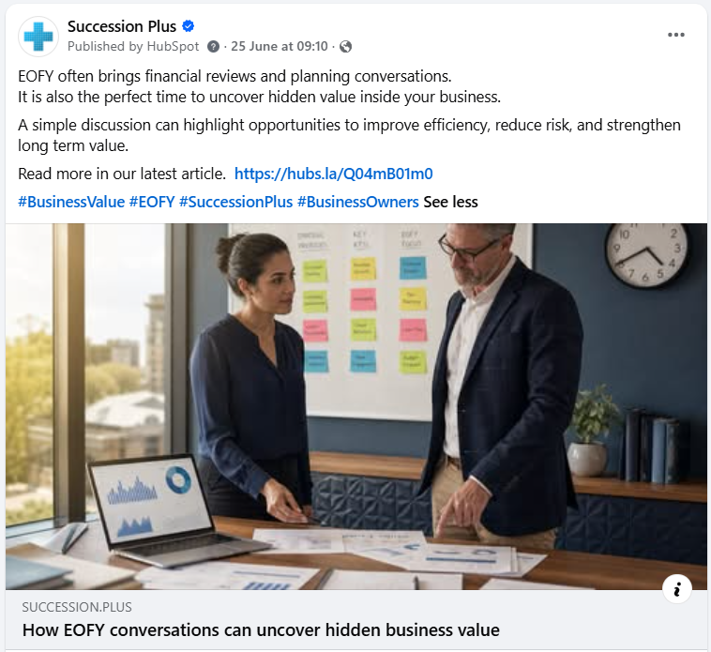
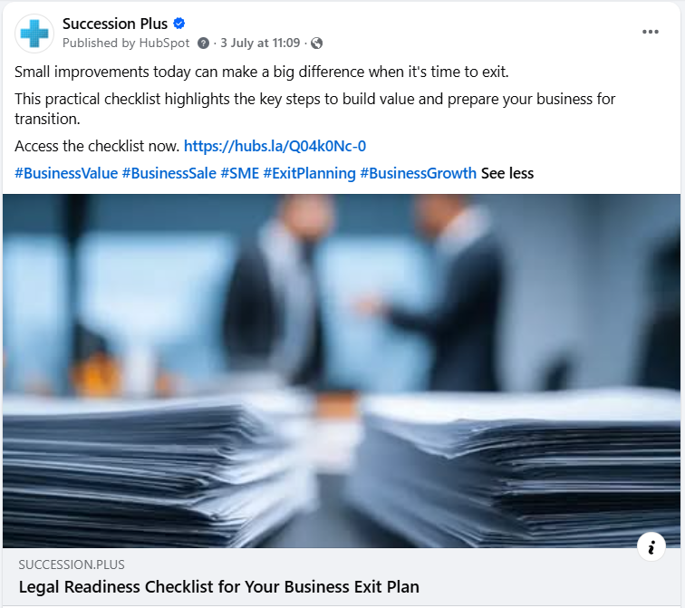
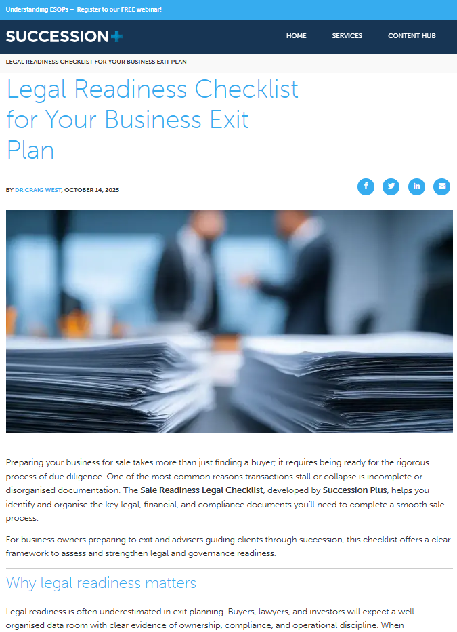
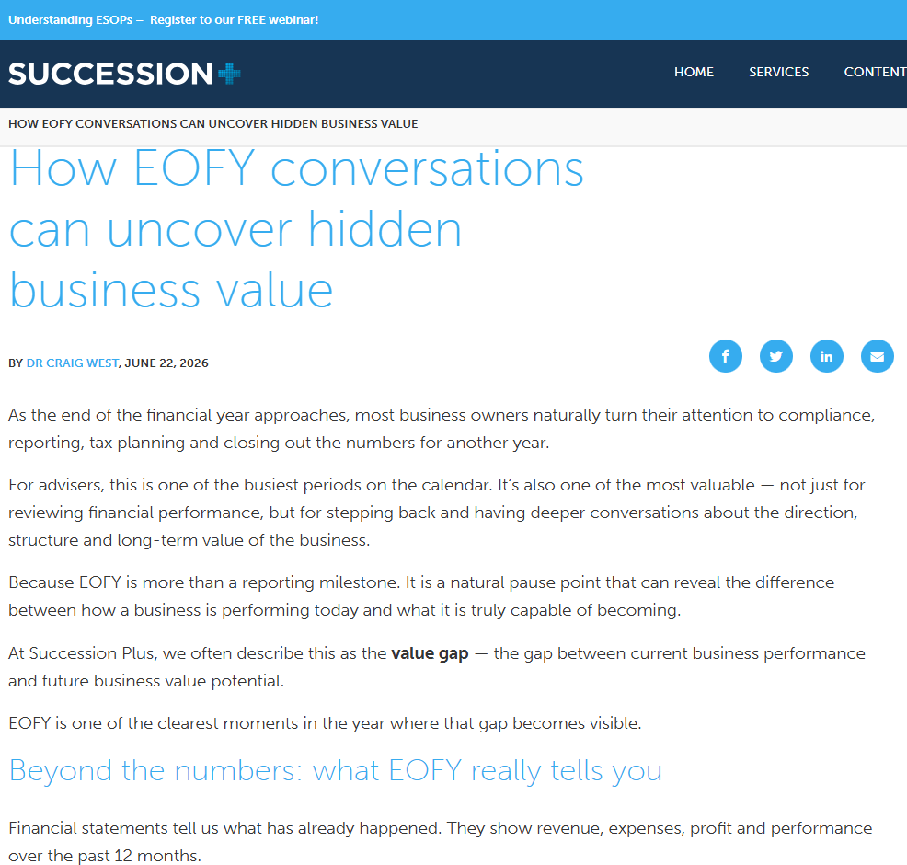
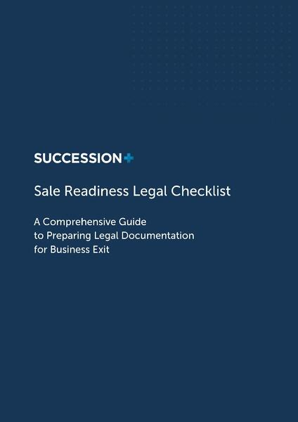
Sample Website Articles
Dr Craig West | Find, Engage, and Win Business Owners

Slide 27
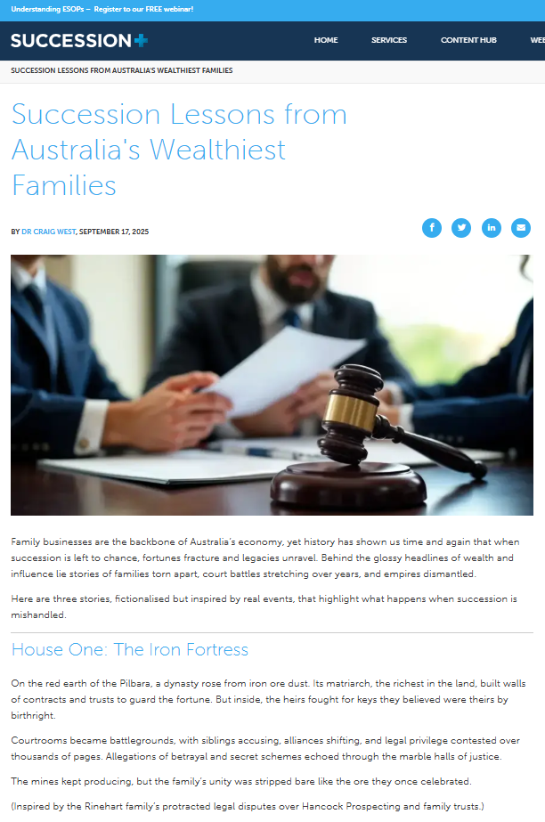
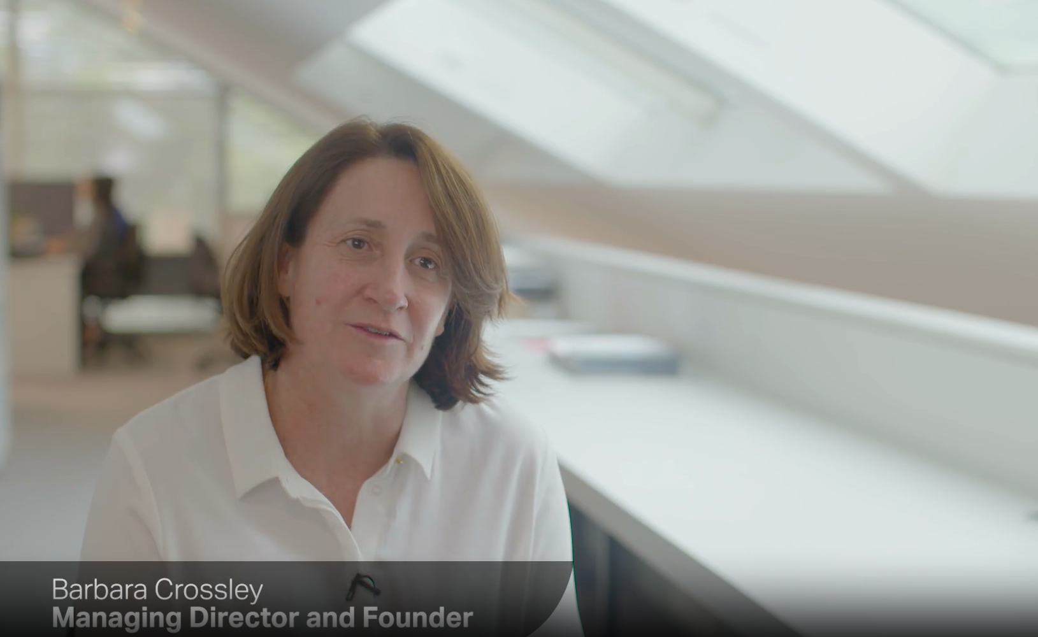
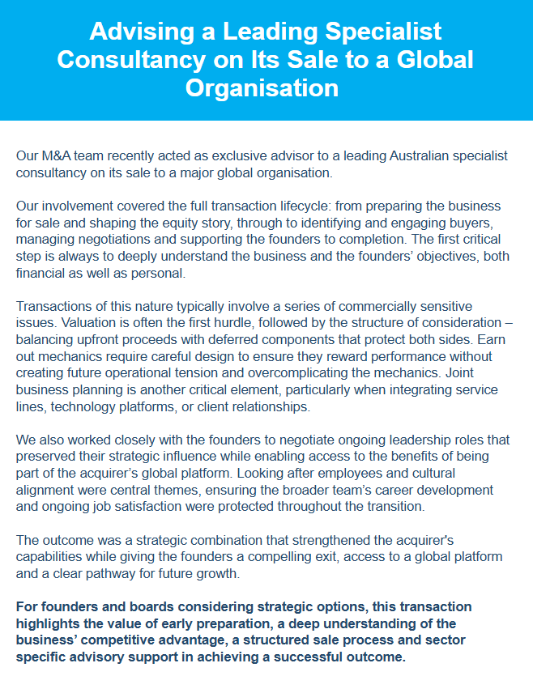

Sample Case Studies
Dr Craig West | Find, Engage, and Win Business Owners

Slide 28


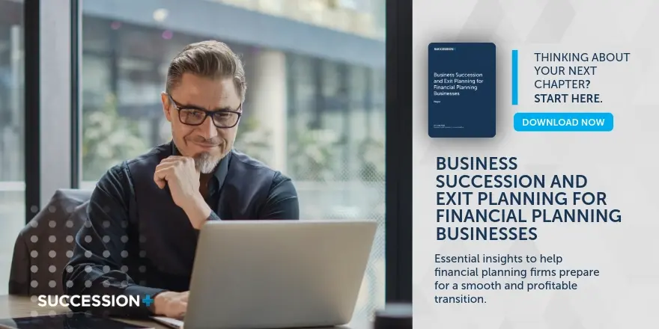


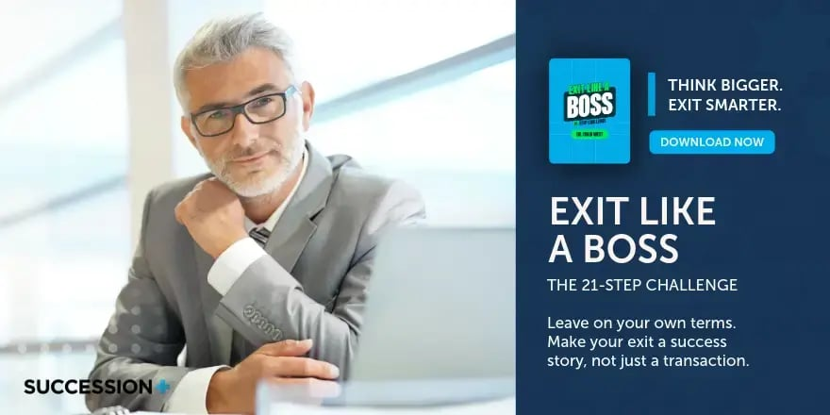
Sample Resources
Dr Craig West | Find, Engage, and Win Business Owners

Slide 29
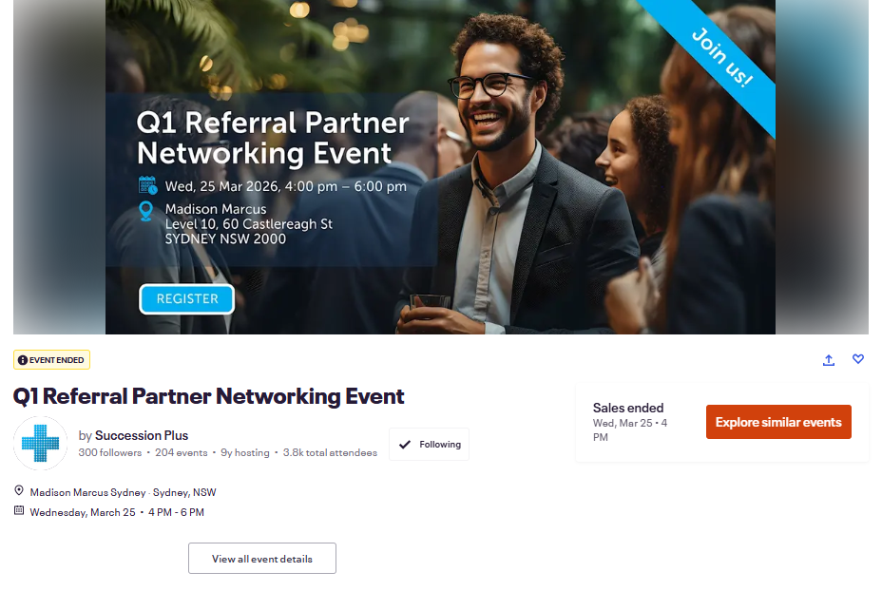
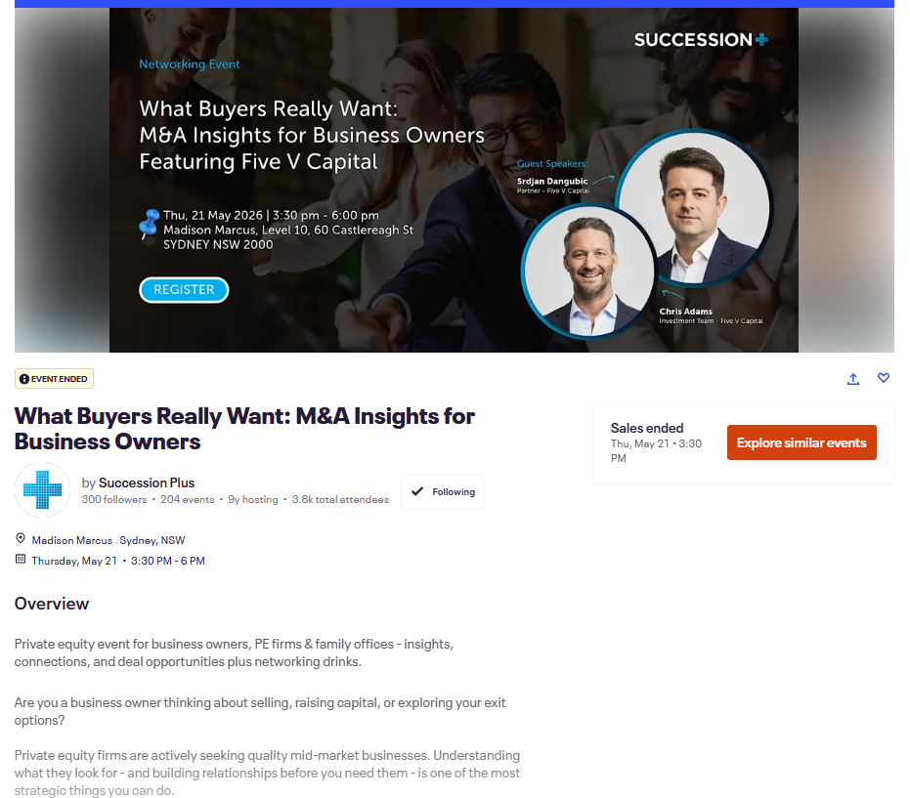
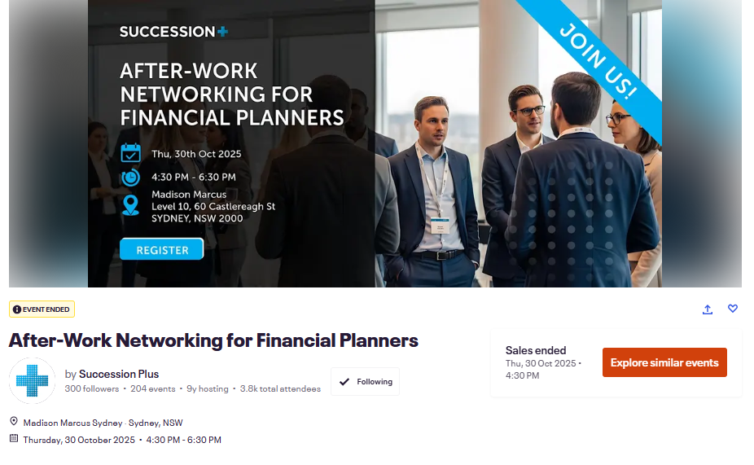
Sample Internal Events
Dr Craig West | Find, Engage, and Win Business Owners

Slide 30
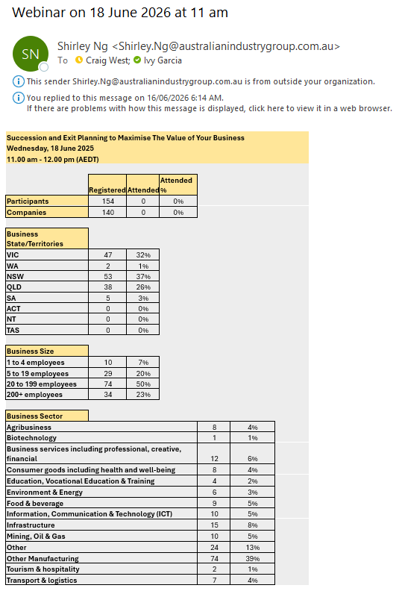

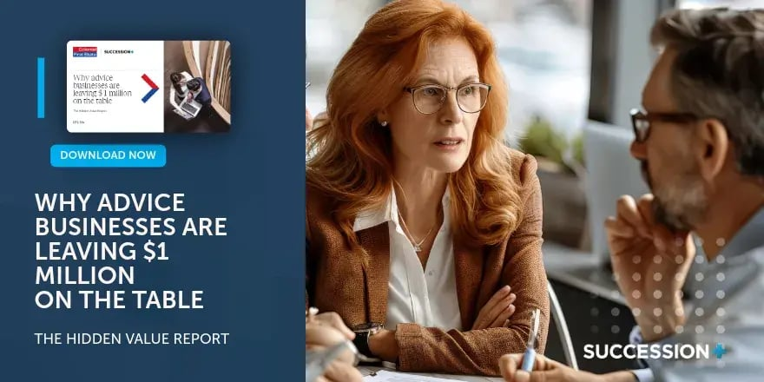
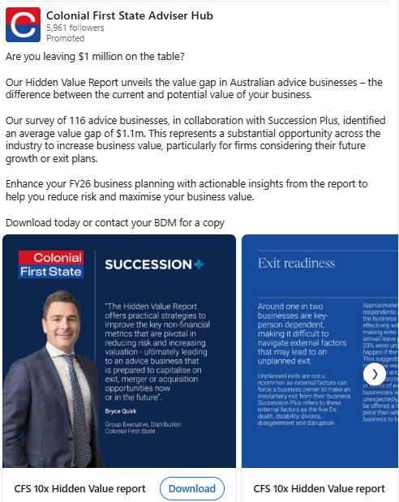
Sample Association Presentations and Collaboration
Dr Craig West | Find, Engage, and Win Business Owners

Slide 31
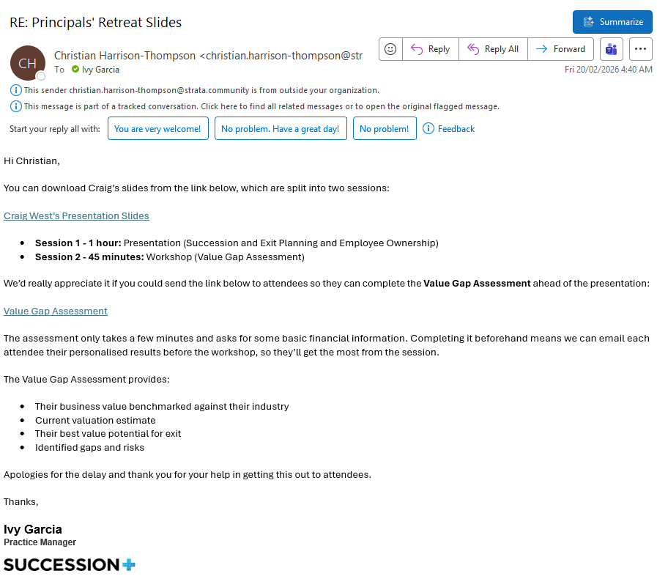
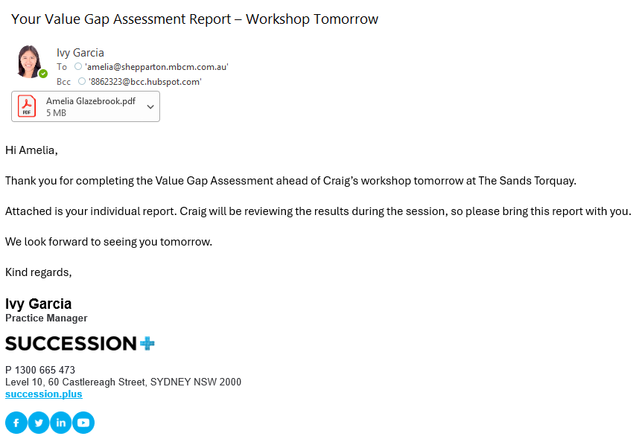
Turning Events into Pipeline
Before
Promote the event
During
Provide practical value
CTA
Invite completion of the VGA
Next Step
Follow up
This is where most advisors lose momentum. The follow-up is more important than the webinar.
Dr Craig West | Find, Engage, and Win Business Owners

Slide 32
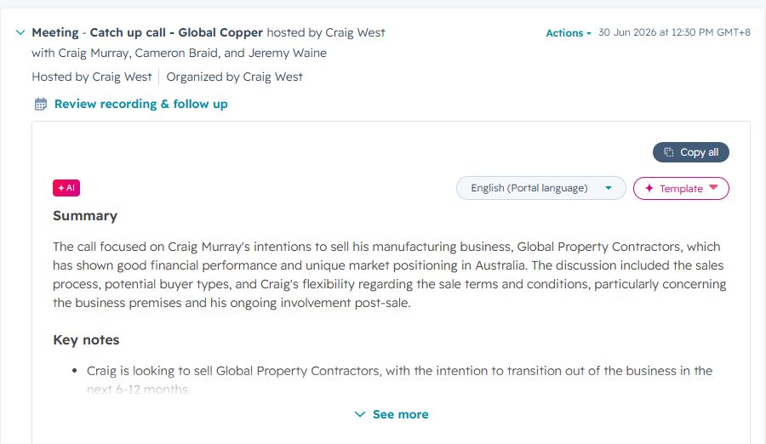
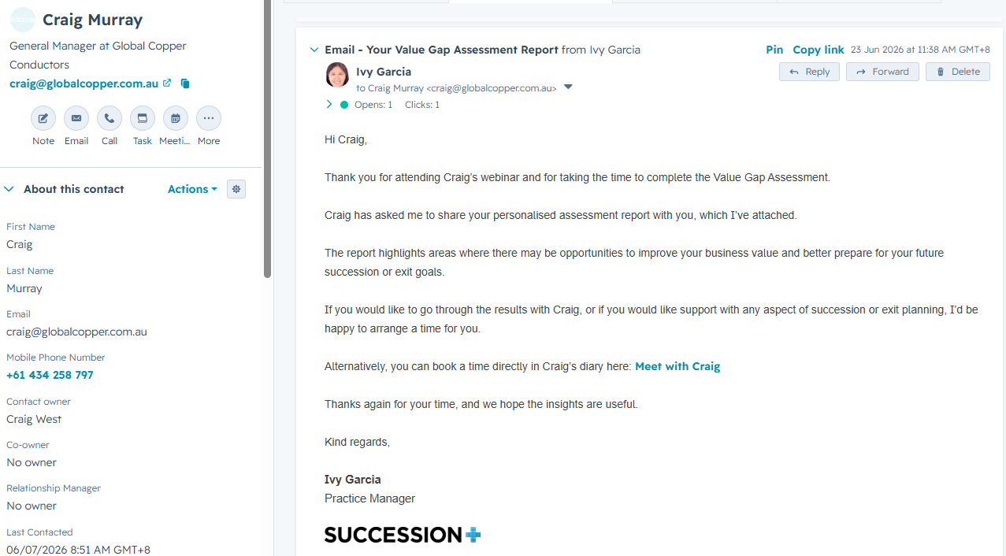
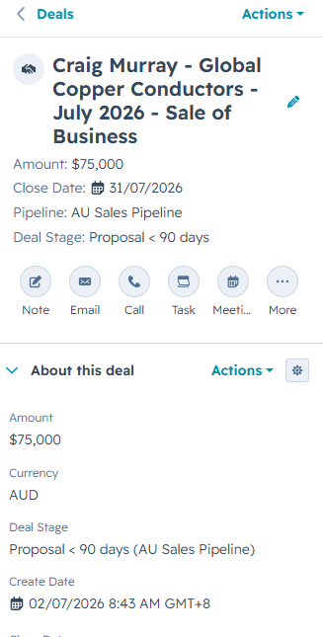
Turning Events into Pipeline
Dr Craig West | Find, Engage, and Win Business Owners

Slide 33
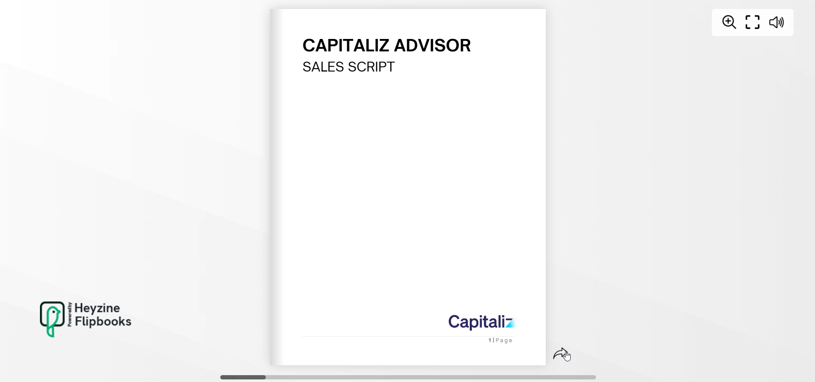

Sample Sales Script
Dr Craig West | Find, Engage, and Win Business Owners

Slide 34

The Advisor’s Playbook
Dr Craig West | Find, Engage, and Win Business Owners

Slide 35
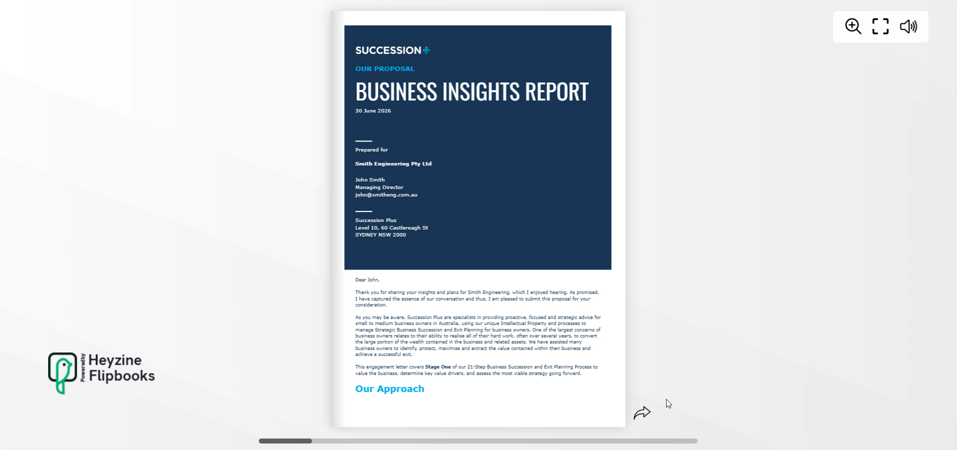
Sample Proposal Template
Dr Craig West | Find, Engage, and Win Business Owners

Slide 36
SECTION 07
Next Steps
Learn how to build a $2M practice in 2 days
Dr Craig West | Find, Engage, and Win Business Owners

Slide 37





Capitaliz Advisors Bootcamp:
Build a $2M Practice in 2 Days
September 1-2 | Dallas, TX
ONE NEW CLIENT PAYS FOR IT.
Everything in today’s session is a preview. The full playbooks, scripts, tools, and coaching live inside the Bootcamp.
The trade-off is time.
The playbooks cut years off
your learning curve.
Full lead generation playbooks (not just the overview)
Complete scripting library for every stage of the journey
Live coaching sessions with the team
Access to Capitaliz platform – your end-to-end delivery tool
A cohort of peers building the same practice alongside you
Learn More About Bootcamp
capitaliz.com/events
Dr Craig West | Find, Engage, and Win Business Owners

Slide 38

Ask Me Anything
Open Q&A
15 minutes for your questions
Suggested questions to get us started:
What's working right now for advisors building pipeline?
How do I price the first engagement?
How long does it take to win the first client?
Dr Craig West | Find, Engage, and Win Business Owners

